Slide 1
VERTEX PROGRAMMING LANGUAGE
Team 2
1] Amulya Bodla (abodla)
2] Niharika Pothana (npothana)
3] Piyush Mudireddy (prmudire)
4] Ritesh Reddy(ranugu)

Slide 2
Glossary
• Overview & Tools Used
• Features
• Workflow
• Lexer
• Grammar
• Compiler
• Intermediate Code Translation
• Sample Code
• Runtime
• Additional Functionalities

Slide 3
Overview & Tools Used
• Lexical Analysis and parsing: Prolog
• Intermediate code generation:
FileName: Intermediate code
Extension: .intc
• Runtime environment: Prolog
• Language extension: .vtex

Slide 4
Features
Arithmetic Operators
Primitive Data Types i.e. integer, Boolean, String.
Boolean operations (AND, OR, NOT)
Assignment Operator
Relation operations (>, <, >=, <=, ==, ~)
Conditional Statements (if-then, if-then-else, ternary)
Display & Displayln
Iterative Statements (for, while, for in range)
Low Level Intermediate Language (.intc files)
Block Structured

Slide 5
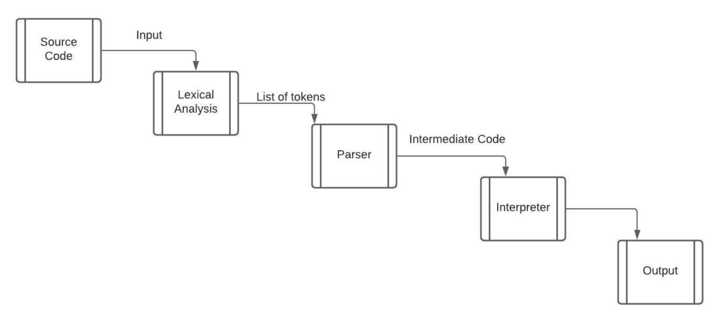
Workflow

Slide 6
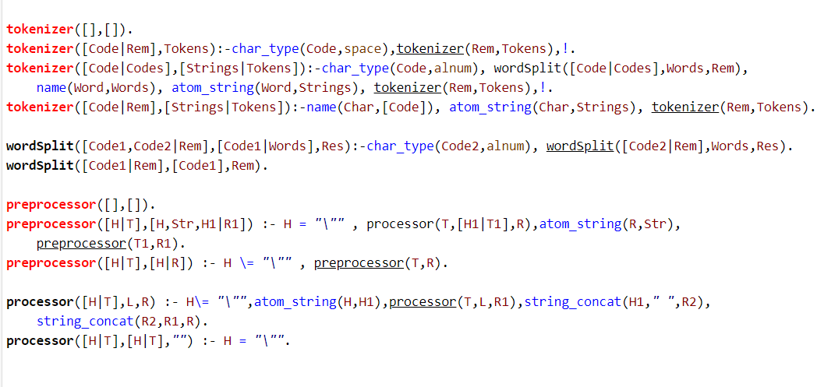
Lexer

Slide 7
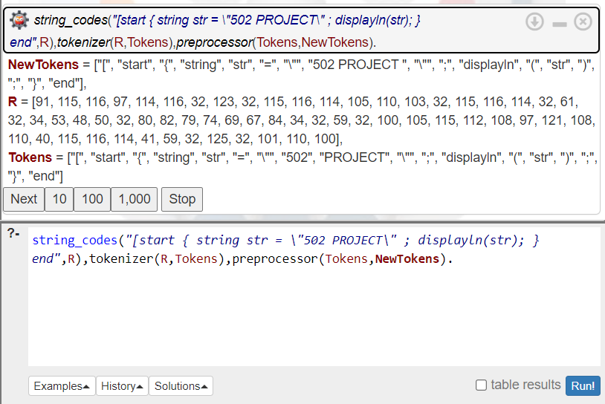
Lexer

Slide 8
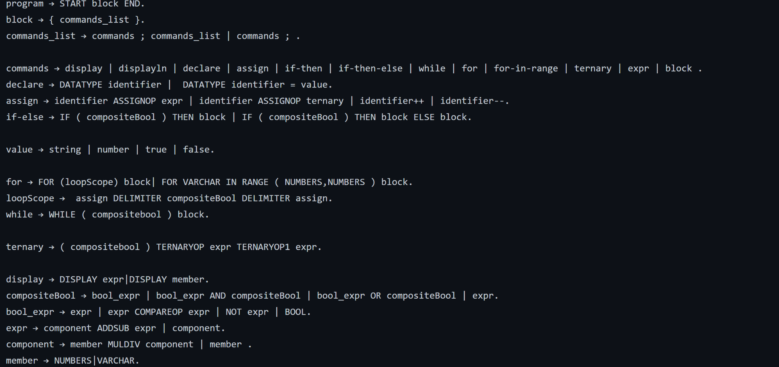
Grammar

Slide 9
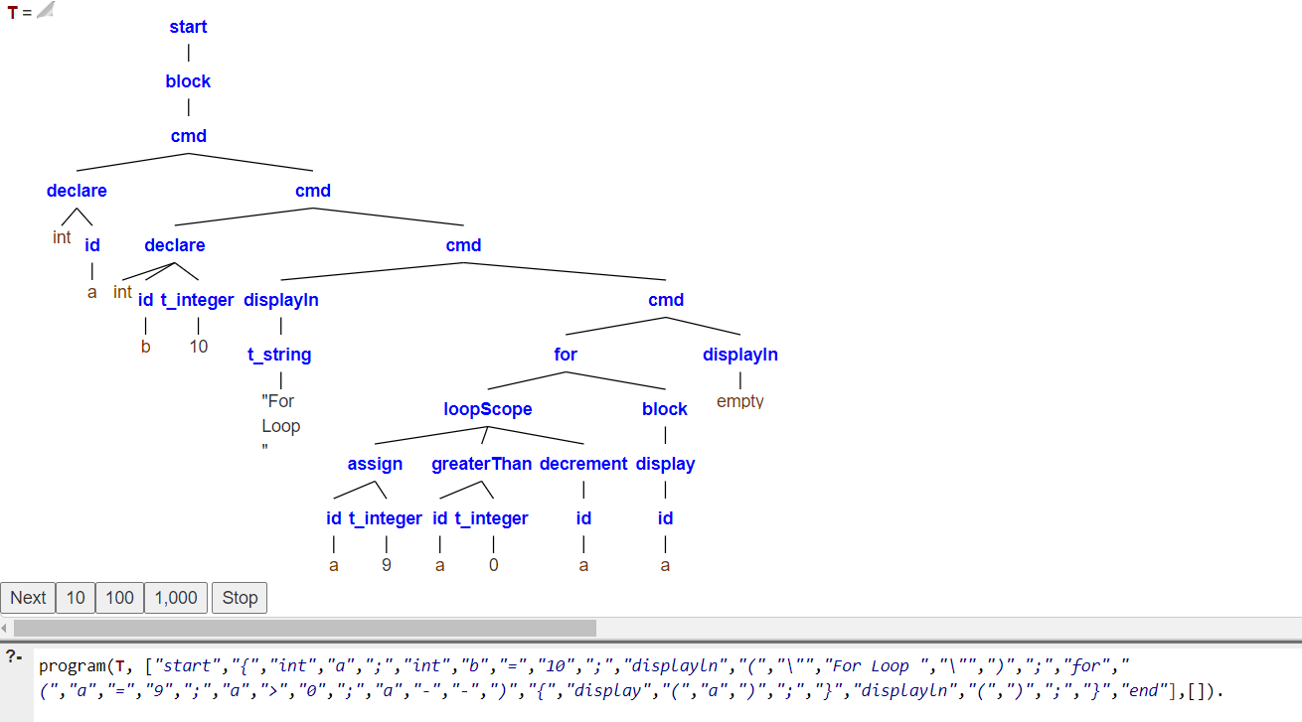
Parse Tree

Slide 10
Additional Features implemented
Print variations (display, displayln , expression evaluation)
Increment and Decrement operators (++, --)
String operations: Concatenation & Reverse functions

Slide 11
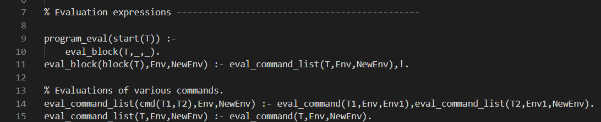
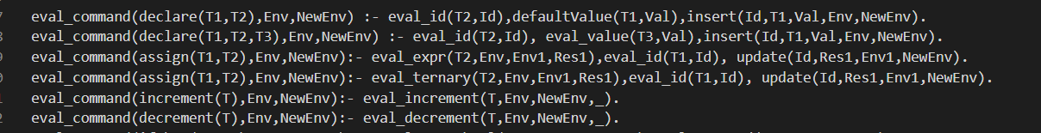
Interpreter

Slide 12
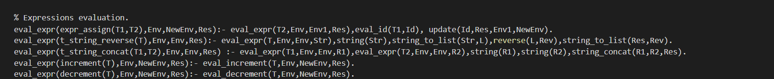
Interpreter

Slide 13
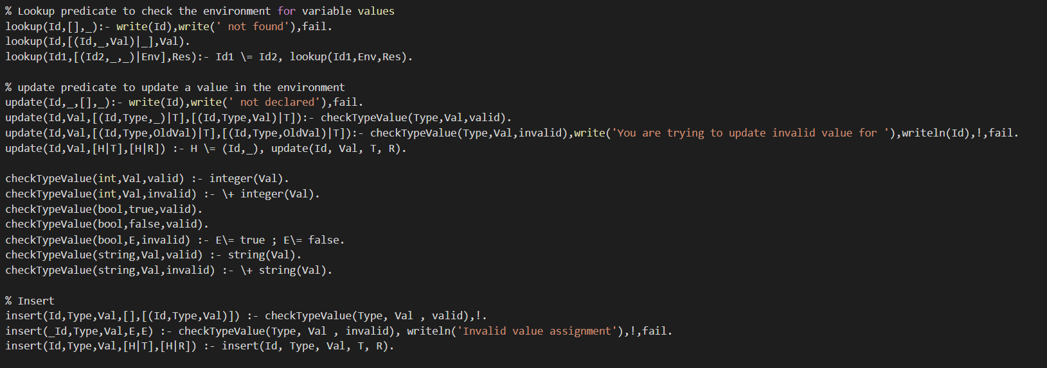
Interpreter

Slide 14
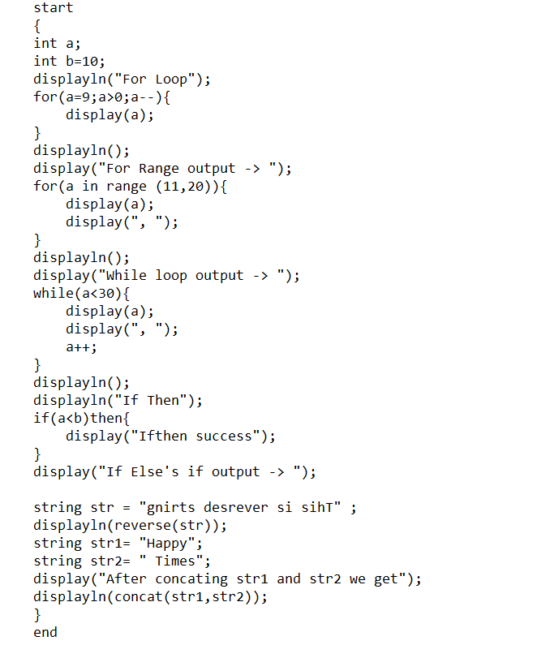
Sample Input

Slide 15
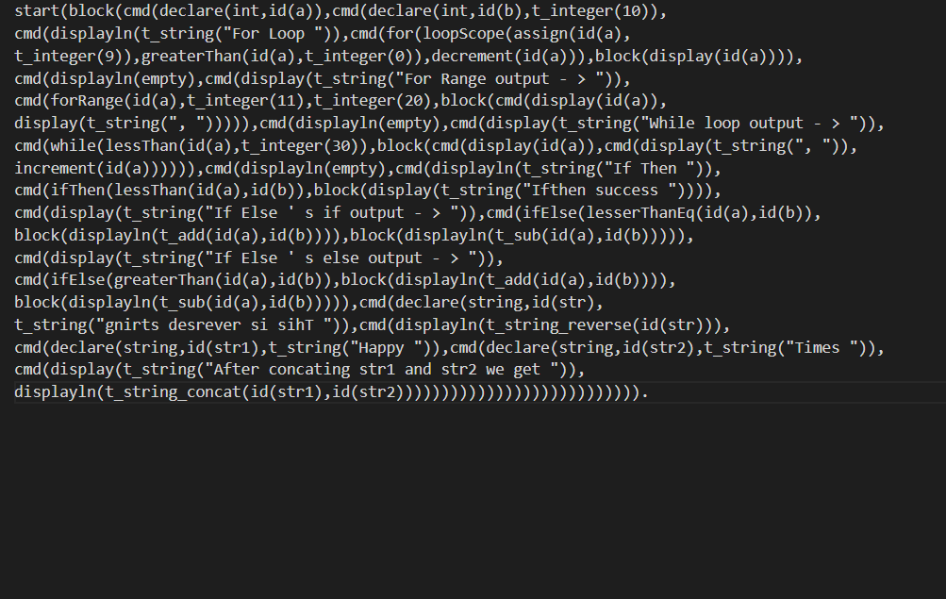
Sample Intermediate Code

Slide 16
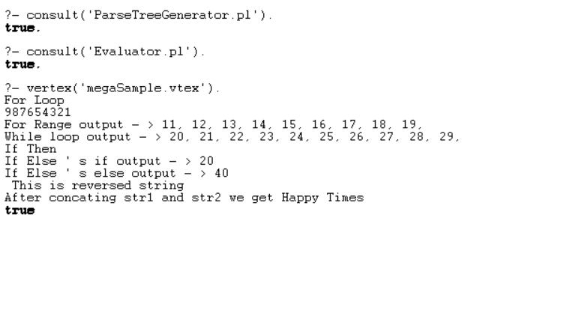
Sample Output

Slide 17
GITHUB LINK: https://github.com/Prmudire/SER502-Spring2021-Team2
Thank You
Amulya Bodla (1219477220)
Niharika Pothana (1219596937)
Ritesh Reddy (1220005293)
Piyush Reddy (1219456537)

